Slide 1

Samplers
Sampler is a type of controller that allows JMeter to send specific types of requests to a server and wait for a response. Each sampler has several properties you can set.
Prepared By: Hemalatha M

Slide 2
Samplers
Jmeter Samplers include:
HTTP Request
FTP Request
JDBC Request
Java Request
SOAP/XML Request
RPC Request

Slide 3
Samplers
HTTP Request
This sampler lets you send an HTTP/HTTPS request to a web server.
It is added to the test plan to perform a POST, GET, or DELETE on a HTTP service. Likewise, we can use other sampler elements according to our need.

Slide 4
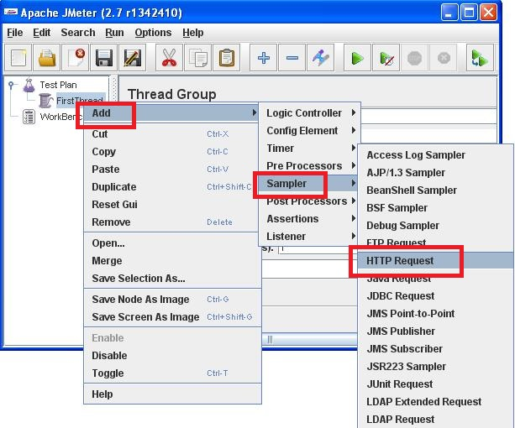
Samplers
HTTP Request
Let's write our first web test plan for testing an http URL. So here are the steps.
Step 1 : Add a HTTP Request to the Thread group, as shown in the below figure.

Slide 5
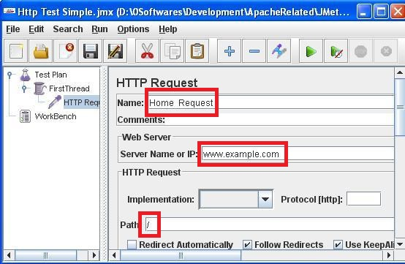
Samplers
HTTP Request
Step 2: In the right-hand pane, add a name for the sampler (ex. Home Request), in the Server name or IP field add your webserver's hostname or IP Address. Let other fields keep the default values. As shown in the below figure

Slide 6
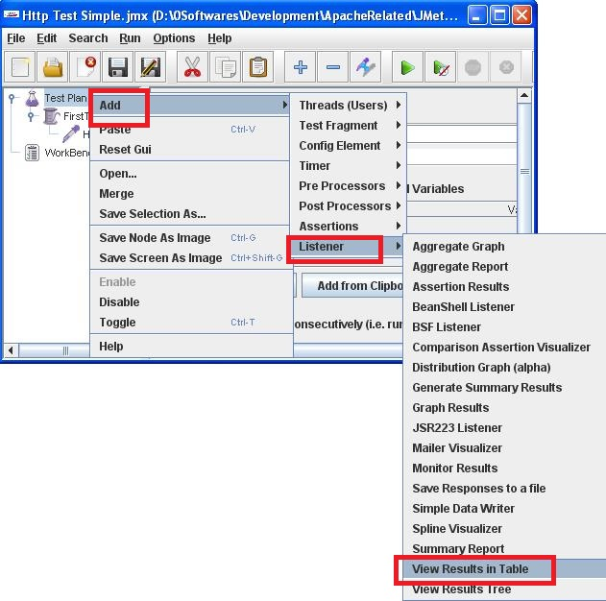
Samplers
HTTP Request
Step 3: Now in order to view the test results, you need a Listener. We will use a tabular listener. Right click on Test Plan and add Listener View Results in Table as shown in the below figure.

Slide 7

Thank You

